Slide 1
OBJECTIVES
Become familiar and understand Java Generics
Java Exceptions
Concept of an File I/O
Understand the difference between binary files and text files
Learn how to save data in a file
Learn how to read data from a file
Notes:
NUCLEUSTEQ CONSULTING PVT LTD

Slide 2
JAVA COLLECTIONS ≤ V1.4
Why Generics?
The initial Java collections stored values of type Object.
  They could store any type, since all types are subclasses of Object.
  But you had to cast the results, which was tedious and error-prone.
    Examining the elements of a collection was not type-safe.
  // in Java 1.4:
  ArrayList names = new ArrayList();
  names.add("Marty Stepp");
  names.add("Stuart Reges");
  String teacher = (String) names.get(0);
  // this will compile but crash at runtime; bad
  Point oops = (Point) names.get(1);

Slide 3
TYPE PARAMETERS (GENERICS)
List<Type> name = new ArrayList<Type>();
Since Java 1.5, when constructing a java.util.ArrayList, we specify the type of elements it will contain between < and >.
  We say that the ArrayList class accepts a type parameter,
  or that it is a generic class.
  Use of the "raw type" ArrayList without <> leads to warnings.
  List<String> names = new ArrayList<String>();
  names.add("Marty Stepp");
  names.add("Stuart Reges");
  String teacher = names.get(0); // no casting is required
  Point oops = (Point) names.get(1); // error at compile time

Slide 4
IMPLEMENTING GENERICS
// a parameterized (generic) class
public class name<Type> {
or
public class name<Type, Type, ..., Type> {
  By putting the Type in < >, you are demanding that any client that constructs your object must supply a type parameter.
    You can require multiple type parameters separated by commas.
  The rest of your class's code can refer to that type by name.
    The convention is to use a 1-letter name such as:
    T for Type, E for Element, N for Number, K for Key, or V for Value.
  The type parameter is instantiated by the client. (e.g. E → String)

Slide 5
COMPARING GENERIC OBJECTS
  public class ArrayList<E> {
  ...
  public int indexOf(E value) {
  for (int i = 0; i < size; i++) {
  // if (elementData[i] == value) {
  if (elementData[i].equals(value)) {
  return i;
  }
  }
  return -1;
  }
  }
  When testing objects of type E for equality, must use equals.
  Not to use ‘==‘ checkout why?

Slide 6
TYPE ERASURE
All generics types become type Object once compiled.
  One reason: Backward compatibility with old byte code.
  At runtime, all generic instantiations have the same type.
  List<String> lst1 = new ArrayList<String>();
  List<Integer> lst2 = new ArrayList<Integer>();
  lst1.getClass() == lst2.getClass() // true
You cannot use instanceof to discover a type parameter.
  Collection<?> cs = new ArrayList<String>();
  if (cs instanceof Collection<String>) {
  // illegal
  }
  What is <?> Checkout as an assignment.

Slide 7
GENERICS AND CASTING
Casting to generic type results in a warning.
  List<?> l = new ArrayList<String>(); // ok
  List<String> ls = (List<String>) l; // warn
  The compiler gives an unchecked warning, since this isn't something the runtime system is going to check for you.
  Usually, if you think you need to do this, you're doing it wrong.
  Reference
  https://www.javatpoint.com/generics-in-java
Notes:
NUCLEUSTEQ CONSULTING PVT LTD

Slide 8
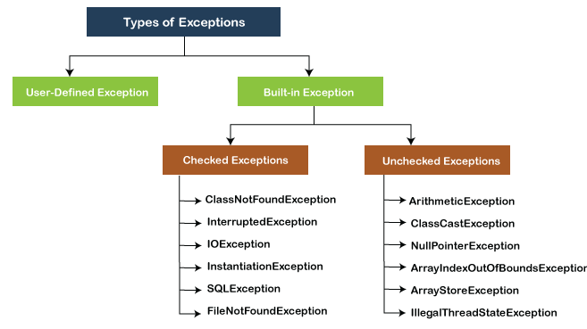
EXCEPTIONS
Issues that lead to abnormal termination of the program under some circumstances or conditions are known as exceptions.
There are mainly two types of exceptions when we are dealing with Built-in Exceptions in Java. (Refer to snap given below)
To prevent program from getting caught with exception, error handling mechanism is applied.
Notes:
NUCLEUSTEQ CONSULTING PVT LTD

Slide 9
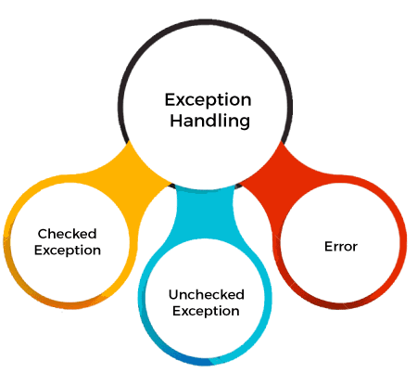
CHECKED VS UNCHECKED VS ERROR
Checked Exception - The classes that directly inherit the Throwable class except RuntimeException and Error are known as checked exceptions. For example, IOException, SQLException, etc. Checked exceptions are checked at compile-time.
Unchecked Exception -The classes that inherit the RuntimeException are known as unchecked exceptions. For example, ArithmeticException, NullPointerException, ArrayIndexOutOfBoundsException, etc. Unchecked exceptions are not checked at compile-time, but they are checked at runtime.
Error - Error is irrecoverable. Some example of errors are OutOfMemoryError, VirtualMachineError, AssertionError etc.
Notes:
NUCLEUSTEQ CONSULTING PVT LTD

Slide 10
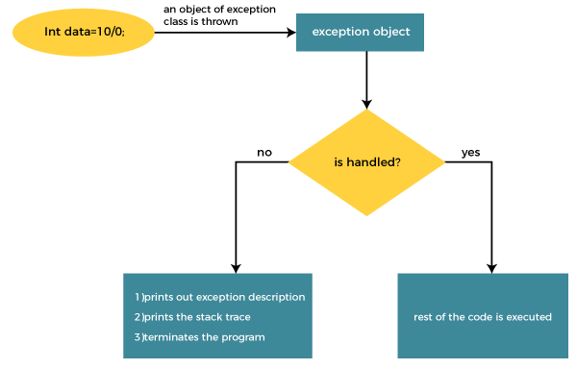
JAVA TRY-CATCH-FINALLY BLOCK
Java try block is used to enclose the code that might throw an exception. It must be used within the method.
If an exception occurs at the particular statement in the try block, the rest of the block code will not execute. So, it is recommended not to keep the code in try block that will not throw an exception.
Java try block must be followed by either catch or finally block.
There can be multiple catch blocks for a simple try block to catch different types of exceptions that can occur during execution of program.
Syntax of Java try-catch
try{
//code that may throw an exception
}catch(Exception_class_Name ref){}
Syntax of try-finally block
try{
//code that may throw an exception
}finally{}
Finally block – Finally Block always executes irrespective of the condition.
Notes:
NUCLEUSTEQ CONSULTING PVT LTD

Slide 11
EXCEPTION HANDLING KEYWORDS
try | The "try" keyword is used to specify a block where we should place an exception code. It means we can't use try block alone. The try block must be followed by either catch or finally.
catch | The "catch" block is used to handle the exception. It must be preceded by try block which means we can't use catch block alone. It can be followed by finally block later.
finally | The "finally" block is used to execute the necessary code of the program. It is executed whether an exception is handled or not.
throw | The "throw" keyword is used to throw an exception.
throws | The "throws" keyword is used to declare exceptions. It specifies that there may occur an exception in the method. It doesn't throw an exception. It is always used with method signature.
Notes:
NUCLEUSTEQ CONSULTING PVT LTD

Slide 12
I/O OVERVIEW
I/O = Input/Output
In this context it is input to and output from programs
Input can be from keyboard or a file
Output can be to display (screen) or a file
Advantages of file I/O
  permanent copy
  output from one program can be input to another
  input can be automated (rather than entered manually)
Notes:
NUCLEUSTEQ CONSULTING PVT LTD

Slide 13
TEXT FILE I/O
Important classes for text file output (to the file)
  PrintWriter
  FileOutputStream [or FileWriter]
Important classes for text file input (from the file):
  BufferedReader
  FileReader
FileOutputStream and FileReader take file names as arguments.
PrintWriter and BufferedReader provide useful methods for easier writing and reading.
Usually need a combination of two classes
To use these classes your program needs a line like the following:
  import java.io.*;
Notes:
NUCLEUSTEQ CONSULTING PVT LTD

Slide 14
BUFFERING
Not buffered: each byte is read/written from/to disk as soon as possible
  “little” delay for each byte
  A disk operation per byte---higher overhead
Buffered: reading/writing in “chunks”
  Some delay for some bytes
    Assume 16-byte buffers
    Reading: access the first 4 bytes, need to wait for all 16 bytes are read from disk to memory
    Writing: save the first 4 bytes, need to wait for all 16 bytes before writing from memory to disk
  A disk operation per a buffer of bytes---lower overhead
Notes:
NUCLEUSTEQ CONSULTING PVT LTD

Slide 15
OUTPUT FILE STREAMS
PrintWriter
FileOutputStream
Memory
Disk
smileyOutStream
smiley.txt
PrintWriter smileyOutStream = new PrintWriter( new FileOutputStream(“smiley.txt”) );
Notes:
NUCLEUSTEQ CONSULTING PVT LTD

Slide 16
TEXT FILE OUTPUT
To open a text file for output: connect a text file to a stream for writing
PrintWriter outputStream =
new PrintWriter(new FileOutputStream("out.txt"));
Similar to the long way:
FileOutputStream s = new FileOutputStream("out.txt");
PrintWriter outputStream = new PrintWriter(s);
Goal: create a PrintWriter object
  which uses FileOutputStream to open a text file
FileOutputStream “connects” PrintWriter to a text file.
Notes:
NUCLEUSTEQ CONSULTING PVT LTD

Slide 17
METHODS FOR PRINTWRITER
Similar to methods for System.out
println
outputStream.println(count + " " + line);
print
format
flush: write buffered output to disk
close: close the PrintWriter stream (and file)
Notes:
NUCLEUSTEQ CONSULTING PVT LTD

Slide 18
TEXT FILE OUTPUT DEMO
PART 1
A try-block is a block:
outputStream would not be accessible to the rest of the method if it were declared inside the try-block
public static void main(String[] args)
{
PrintWriter outputStream = null;
try
{
outputStream =
new PrintWriter(new FileOutputStream("out.txt"));
}
catch(FileNotFoundException e)
{
System.out.println("Error opening the file out.txt. “
+ e.getMessage());
System.exit(0);
}
Opening the file
Creating a file can cause the FileNotFound-Exception if the new file cannot be made.
Notes:
NUCLEUSTEQ CONSULTING PVT LTD

Slide 19
TEXT FILE OUTPUT DEMO
PART 2
System.out.println("Enter three lines of text:");
String line = null;
int count;
for (count = 1; count <= 3; count++)
{
line = keyboard.nextLine();
outputStream.println(count + " " + line);
}
outputStream.close();
System.out.println("... written to out.txt.");
}
Writing to the file
Closing the file
The println method is used with two different streams: outputStream and System.out
Notes:
NUCLEUSTEQ CONSULTING PVT LTD

Slide 20
GOTCHA: OVERWRITING A FILE
Opening an output file creates an empty file
Opening an output file creates a new file if it does not already exist
Opening an output file that already exists eliminates the old file and creates a new, empty one
  data in the original file is lost
To see how to check for existence of a file, see the section of the text that discusses the File class (later slides).
Notes:
NUCLEUSTEQ CONSULTING PVT LTD

Slide 21
JAVA TIP: APPENDING TO A TEXT FILE
To add/append to a file instead of replacing it, use a different constructor for FileOutputStream:
outputStream =
new PrintWriter(new FileOutputStream("out.txt", true));
Second parameter: append to the end of the file if it exists?
Sample code for letting user tell whether to replace or append:
System.out.println("A for append or N for new file:");
char ans = keyboard.next().charAt(0);
boolean append = (ans == 'A' || ans == 'a');
outputStream = new PrintWriter(
new FileOutputStream("out.txt", append));
true if user enters 'A'
Notes:
NUCLEUSTEQ CONSULTING PVT LTD

Slide 22
FAQ: WHY BOTHER TO CLOSE A FILE?
If a program automatically closes files when it ends normally, why close them with explicit calls to close?
Two reasons:
1. To make sure it is closed if a program ends abnormally (it could get damaged if it is left open).
2. A file opened for writing must be closed before it can be opened for reading.
    Although Java does have a class that opens a file for both reading and writing, it is not used in this text.
Notes:
NUCLEUSTEQ CONSULTING PVT LTD

Slide 23
CLOSING A FILE
An output file should be closed when you are done writing to it (and an input file should be closed when you are done reading from it).
Use the close method of the class PrintWriter (BufferedReader also has a close method).
For example, to close the file opened in the previous example:
  outputStream.close();
If a program ends normally it will close any files that are open.
Notes:
NUCLEUSTEQ CONSULTING PVT LTD

Slide 24
INPUT FILE STREAMS
BufferedReader
FileReader
Memory
Disk
smileyInStream
smiley.txt
BufferedReader smileyInStream = new BufferedReader( new FileReader(“smiley.txt”) );
Notes:
NUCLEUSTEQ CONSULTING PVT LTD

Slide 25
TEXT FILE INPUT
To open a text file for input: connect a text file to a stream for reading
  Goal: a BufferedReader object,
    which uses FileReader to open a text file
  FileReader “connects” BufferedReader to the text file
For example:
  BufferedReader smileyInStream =
  new BufferedReader(new FileReader(“smiley.txt"));
Similarly, the long way:
  FileReader s = new FileReader(“smiley.txt");
  BufferedReader smileyInStream = new BufferedReader(s);
Notes:
NUCLEUSTEQ CONSULTING PVT LTD

Slide 26
METHODS FOR BUFFEREDREADER
readLine: read a line into a String
no methods to read numbers directly, so read numbers as Strings and then convert them (StringTokenizer later)
read: read a char at a time
close: close BufferedReader stream
Notes:
NUCLEUSTEQ CONSULTING PVT LTD

Slide 27
EXCEPTION HANDLING WITH FILE I/O
Catching IOExceptions
IOException is a predefined class
File I/O might throw an IOException
catch the exception in a catch block that at least prints an error message and ends the program
FileNotFoundException is derived from IOException
  therefor any catch block that catches IOExceptions also catches FileNotFoundExceptions
  put the more specific one first (the derived one) so it catches specifically file-not-found exceptions
  then you will know that an I/O error is something other than file-not-found
Notes:
NUCLEUSTEQ CONSULTING PVT LTD

Slide 28
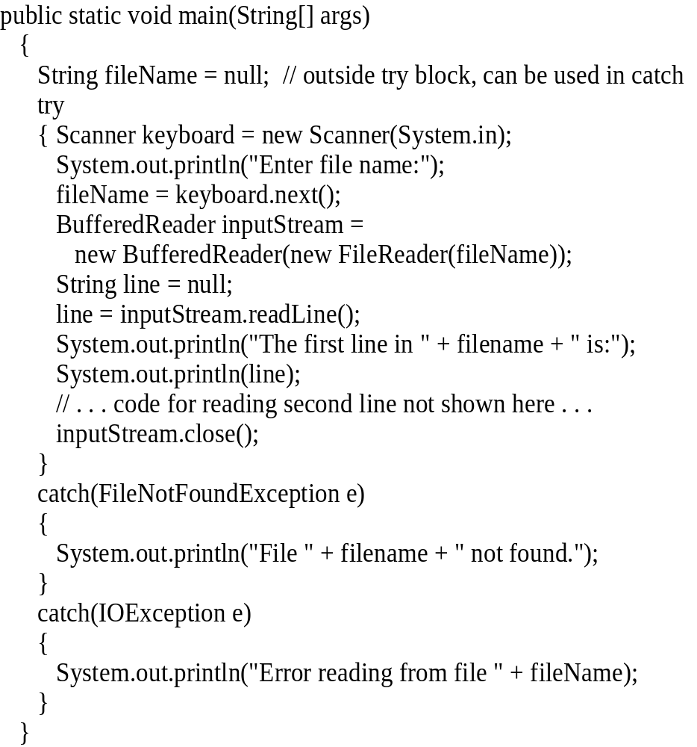
EXAMPLE:
READING A FILE NAME FROM THE KEYBOARD
reading a file name from the keyboard
using the file name read from the keyboard
closing the file
reading data from the file
Notes:
NUCLEUSTEQ CONSULTING PVT LTD

Slide 29
TESTING FOR END OF FILE IN A TEXT FILE
When readLine tries to read beyond the end of a text file it returns the special value null
  so you can test for null to stop processing a text file
read returns -1 when it tries to read beyond the end of a text file
  the int value of all ordinary characters is nonnegative
Neither of these two methods (read and readLine) will throw an EOFException.
Notes:
NUCLEUSTEQ CONSULTING PVT LTD

Slide 30
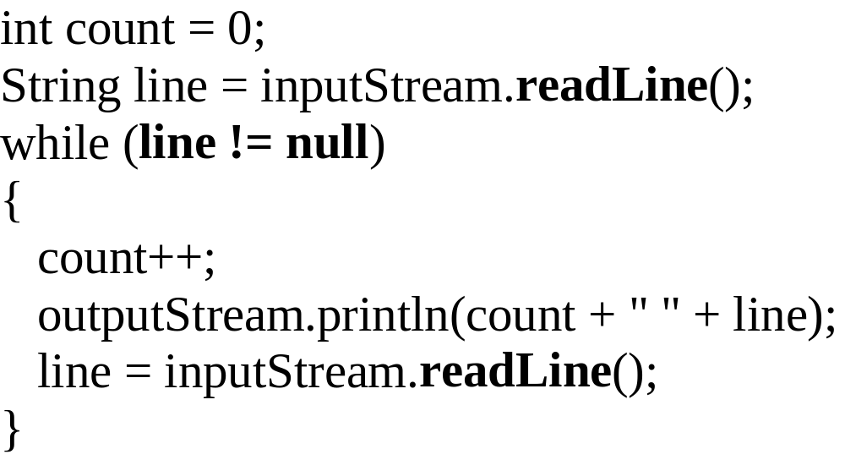
EXAMPLE: USING NULL TO
TEST FOR END-OF-FILE IN A TEXT FILE
When using readLine
test for null
Excerpt from TextEOFDemo
When using read test for -1
Notes:
NUCLEUSTEQ CONSULTING PVT LTD

Slide 31
FILE CLASS [JAVA.IO]
Acts like a wrapper class for file names
A file name like "numbers.txt" has only String properties
File has some very useful methods
  exists: tests if a file already exists
  canRead: tests if the OS will let you read a file
  canWrite: tests if the OS will let you write to a file
  delete: deletes the file, returns true if successful
  length: returns the number of bytes in the file
  getName: returns file name, excluding the preceding path
  getPath: returns the path name—the full name
File numFile = new File(“numbers.txt”);
if (numFile.exists())
System.out.println(numfile.length());
Notes:
NUCLEUSTEQ CONSULTING PVT LTD

Slide 32
ALTERNATIVE WITH SCANNER
Instead of BufferedReader with FileReader
Use Scanner with File:
Scanner inFile = new Scanner(new File(“in.txt”));
Similar to Scanner with System.in:
Scanner keyboard = new Scanner(System.in);
Scanner inFile = new Scanner(new File(“in.txt"));
int number;
while (inFile.hasInt())
{
number = inFile.nextInt();
// …
}

Slide 33
READING IN LINES OF CHARACTERS
Scanner inFile = new Scanner(new File(“in.txt"));
String line;
while (inFile.hasNextLine())
{
line = inFile.nextLine();
// …
}

Slide 34
MULTIPLE TYPES ON ONE LINE
// Name, id, balance
Scanner inFile = new Scanner(new File(“in.txt"));
while (inFile.hasNext())
{
name = inFile.next();
id = inFile.nextInt();
balance = inFile.nextFloat();
// … new Account(name, id, balance);
}
--------------------
String line;
while (inFile.hasNextLine())
{
line = inFile.nextLine();
Scanner parseLine = new Scanner(line) // Scanner again!
name = parseLine.next();
id = parseLine.nextInt();
balance = parseLine.nextFloat();
// … new Account(name, id, balance);
}

Slide 35
MULTIPLE TYPES ON ONE LINE
// Name, id, balance
Scanner inFile = new Scanner(new File(“in.txt"));
String line;
while (inFile.hasNextLine())
{
line = inFile.nextLine();
Account account = new Account(line);
}
--------------------
public Account(String line) // constructor
{
Scanner accountLine = new Scanner(line);
_name = accountLine.next();
_id = accountLine.nextInt();
_balance = accountLine.nextFloat();
}

Slide 36
BUFFEREDREADER VS SCANNER
(PARSING PRIMITIVE TYPES)
Scanner
  nextInt(), nextFloat(), … for parsing types
BufferedReader
  read(), readLine(), … none for parsing types
  needs StringTokenizer then wrapper class methods like Integer.parseInt(token)

Slide 37
BUFFEREDREADER VS SCANNER
(CHECKING END OF FILE/STREAM (EOF))
BufferedReader
  readLine() returns null
  read() returns -1
Scanner
  nextLine() throws exception
  needs hasNextLine() to check first
  nextInt(), hasNextInt(), …

Slide 38
BufferedReader inFile = …
line = inFile.readline();
while (line != null)
{
// …
line = inFile.readline();
}
-------------------
Scanner inFile = …
while (inFile.hasNextLine())
{
line = infile.nextLine();
// …
}

Slide 39
BufferedReader inFile = …
line = inFile.readline();
while (line != null)
{
// …
line = inFile.readline();
}
-------------------
BufferedReader inFile = …
while ((line = inFile.readline()) != null)
{
// …
}

Slide 40
MY SUGGESTION
Use Scanner with File
  new Scanner(new File(“in.txt”))
Use hasNext…() to check for EOF
  while (inFile.hasNext…())
Use next…() to read
  inFile.next…()
Simpler and you are familiar with methods for Scanner
File input
  Scanner inFile =
  new Scanner(new File(“in.txt”));
File output
  PrintWriter outFile =
  new PrintWriter(new File(“out.txt”));
  outFile.print(), println(), format(), flush(), close(), …

Slide 41
ASSIGNMENT-
What are the InputStream and OutputStream classes available to deal with Files.
Try Simple Programs to deep dive into Generics
Learn about Wildcards in Generics
Try File read write programs
WAP to implement use of throw and throws
Try different exceptions and build custom exception.
Build Employee Management Application with File Handling
References –
https://www.javatpoint.com/exception-handling-in-java
https://www.javatpoint.com/generics-in-java
https://www.javatpoint.com/file-operations-in-java
Notes:
NUCLEUSTEQ CONSULTING PVT LTD

